Slide 1
Bake Off 3 - Team 8
By Giuseppe Schintu and Jesse Hatton

Slide 2
Initial Ideas
Scroll wheel of letters
Small Keyboard with word suggestions (autocomplete).
Change backspace to an Icon.
Place the next button inside the watch face.

Slide 3
Scaffold test
Scaffold Code Test Run |  | Total letters expected | Errors | Raw WPM | Total letters entered | Total time Taken | Penalty | WPM w/ Penalty
1 |  | 64 | 0 | 2.771 | 64 | 277.086 | 0 | 2.771
2 |  | 47 | 0 | 2.868 | 47 | 232.245 | 0 | 2.868
3 |  | 52 | 0 | 1.89 | 52 | 276.445 | 0 | 1.89
4 |  | 62 | 1 | 2.644 | 62 | 279.589 | 0 | 2.045
5 |  | 58 | 0 | 2.989 | 58 | 246.088 | 0 | 2.468
Average Test Run |  | 56.6 | .2 | 2.632 | 56.6 | 262.290 | 0 | 2.632

Slide 4
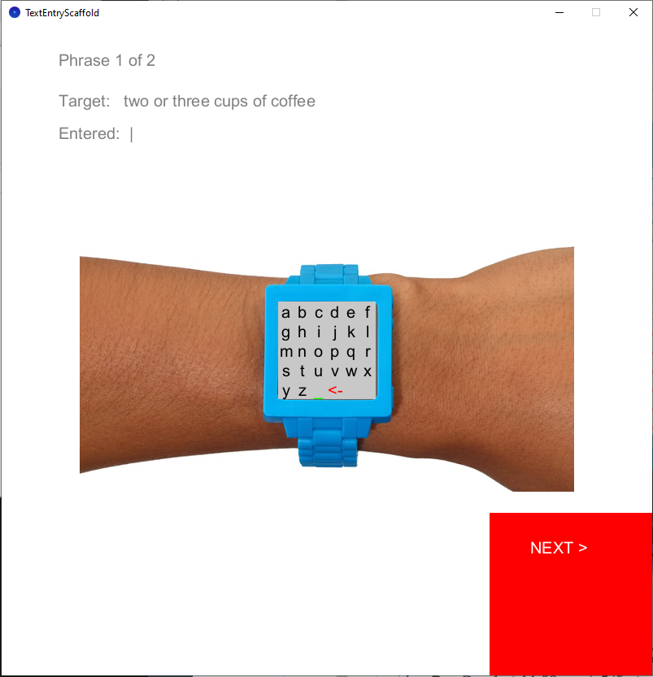
1st Prototype -
The first iteration includes 26 letter keyboard, a space key symbol ( _ ), and backspace symbol ( <- ).

Slide 5
1st Testing
Scaffold Code Test Run |  | Total letters expected | Errors | Raw WPM | Total letters entered | Total time Taken | Penalty | WPM w/ Penalty
1 |  | 68 | 0 | 9.577 | 68 | 85.2 | 0 | 9.577
2 |  | 59 | 0 | 10.501 | 59 | 67.418 | 0 | 10.501
3 |  | 63 | 0 | 8.410 | 63 | 89.885 | 0 | 8.410
4 |  | 47 | 0 | 8.834 | 47 | 58.834 | 0 | 8.834
5 |  | 55 | 0 | 10.740 | 55 | 61.541 | 0 | 10.740
Average Test Run |  | 58.4 | 0 | 9.612 | 58.4 | 72.576 | 0 | 9.612

Slide 6

1st Refinement
Changed space and backspace symbols to ‘sp’ for space and ‘bk’ for backspace.

Slide 7
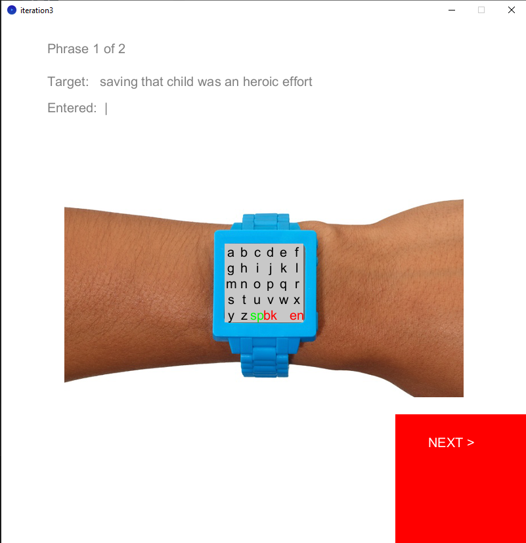
2nd Prototype -
The 2nd prototype places the next button on the watch face ‘en.’

Slide 8
2nd Testing
Scaffold Code Test Run |  | Total letters expected | Errors | Raw WPM | Total letters entered | Total time Taken | Penalty | WPM w/ Penalty
1 |  | 54 | 14 | 11.232 | 40 | 42.733 | 5.65 | 5.582
2 |  | 46 | 0 | 8.798 | 46 | 62.739 | 0 | 8.798
3 |  | 52 | 1 | 11-484 | 52 | 54.336 | 0 | 11.484
4 |  | 63 | 0 | 11.189 | 59 | 63.267 | 0 | 11.189
5 |  | 58 | 1 | 23.024 | 57 | 56.882 | 0 | 12.024
Average Test Run |  | 54.6 | 3.2 | 13.145 | 50.8 | 55.991 | 1.13 | 12.015

Slide 9
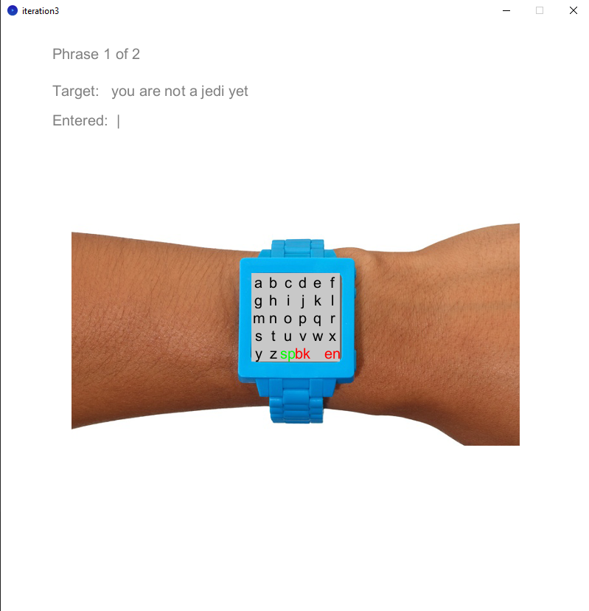
Final Refinement
Removed External next button

